Slide 1
IS STRENGTHENING WITH ISO/IEC 27001:2022
PRESENTED BY : TANIA BWARI [ISO CONSULTANT]

Slide 2
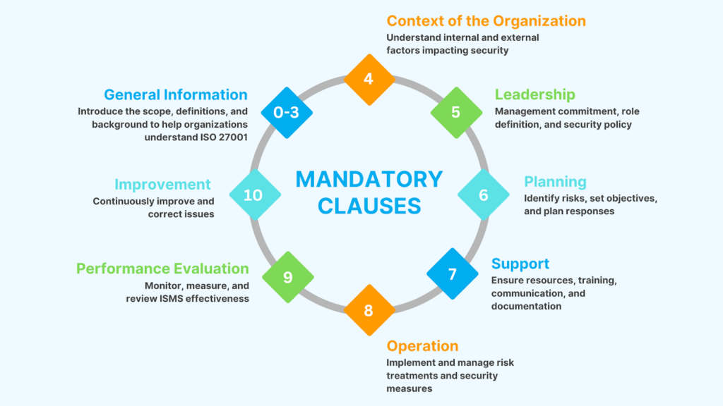
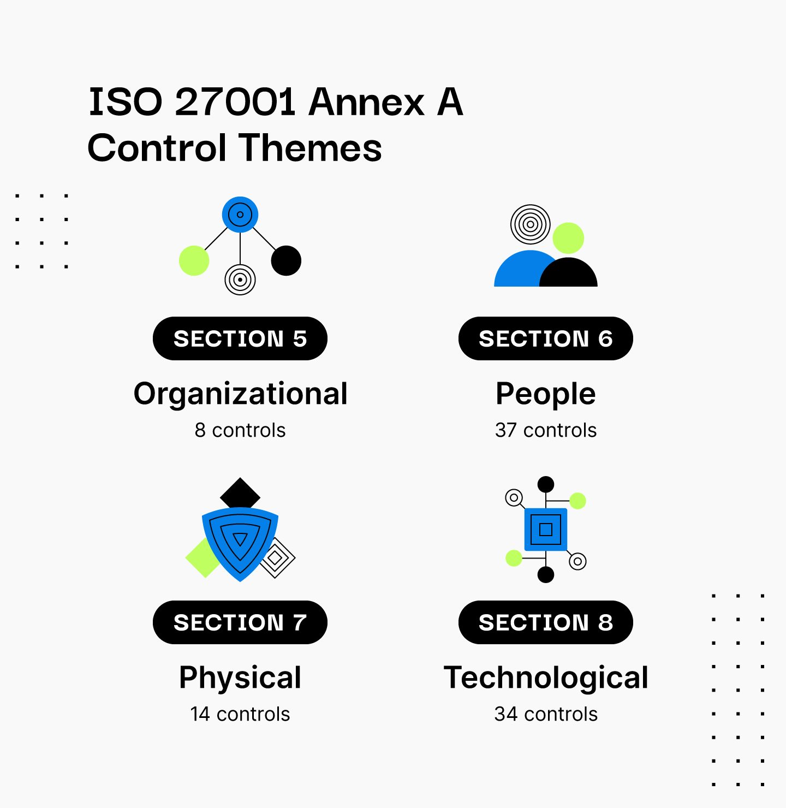
ISO/IEC 27001: 2022
It is an international standard for establishing, implementing, maintaining and continually improving an Information Security Management Systems (ISMS)
It focuses on :
Provides structured risk-based security governance
Protecting confidentiality, integrity and availability of information
Aligning security controls with business objectives
Helps organizations identify, analyze and treat risks systematically

Slide 3
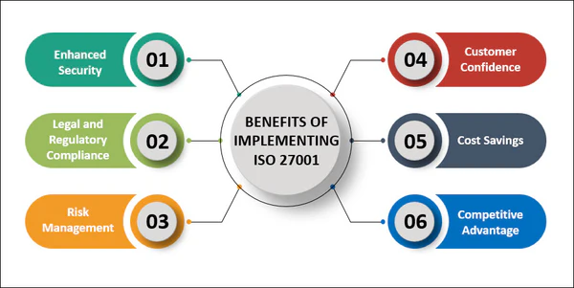
WHY ISO 27001 IS IMPORTANT TO A SACCO
For Nususi SACCO, ISO 27001 supports:
Protection of member personal and financial data
Secure operation of core banking and digital channels
Compliance with regulatory and legal regulations
Stronger oversight of vendors and outsourced services
Improves governance and accountability

Slide 4

COST-BENEFIT ANALYSIS
COST
Certification cost estimation in Kenya – KES 300,000 – 1,500,000 – Depending on scope and complexity
BENEFITS
Breach cost avoidance – Global Average breach cost is $4.45M
Reduced audit & Compliance costs – Fewer client/ vendor audits
Operational efficiency – Unified processes reducing duplication and inefficiency
Increased trust & competitiveness – Certified organizations promote trust, securing more business
Reduced risk of fines – Stronger regulatory and legal compliance
SASRA – Requires strong internal controls
Kenya Data Protection Act (2019) – Requires data protection controls on financial and personal data

Slide 5
HIGH-LEVEL IMPLEMENTATION APPROACH
Scope Definition & Leadership Commitment
Gap Analysis & Risk Assessment
Control Selection & Documentation
Control Implementation & Awareness Training
Internal Audit & Management Review
Certification Readines

Slide 6
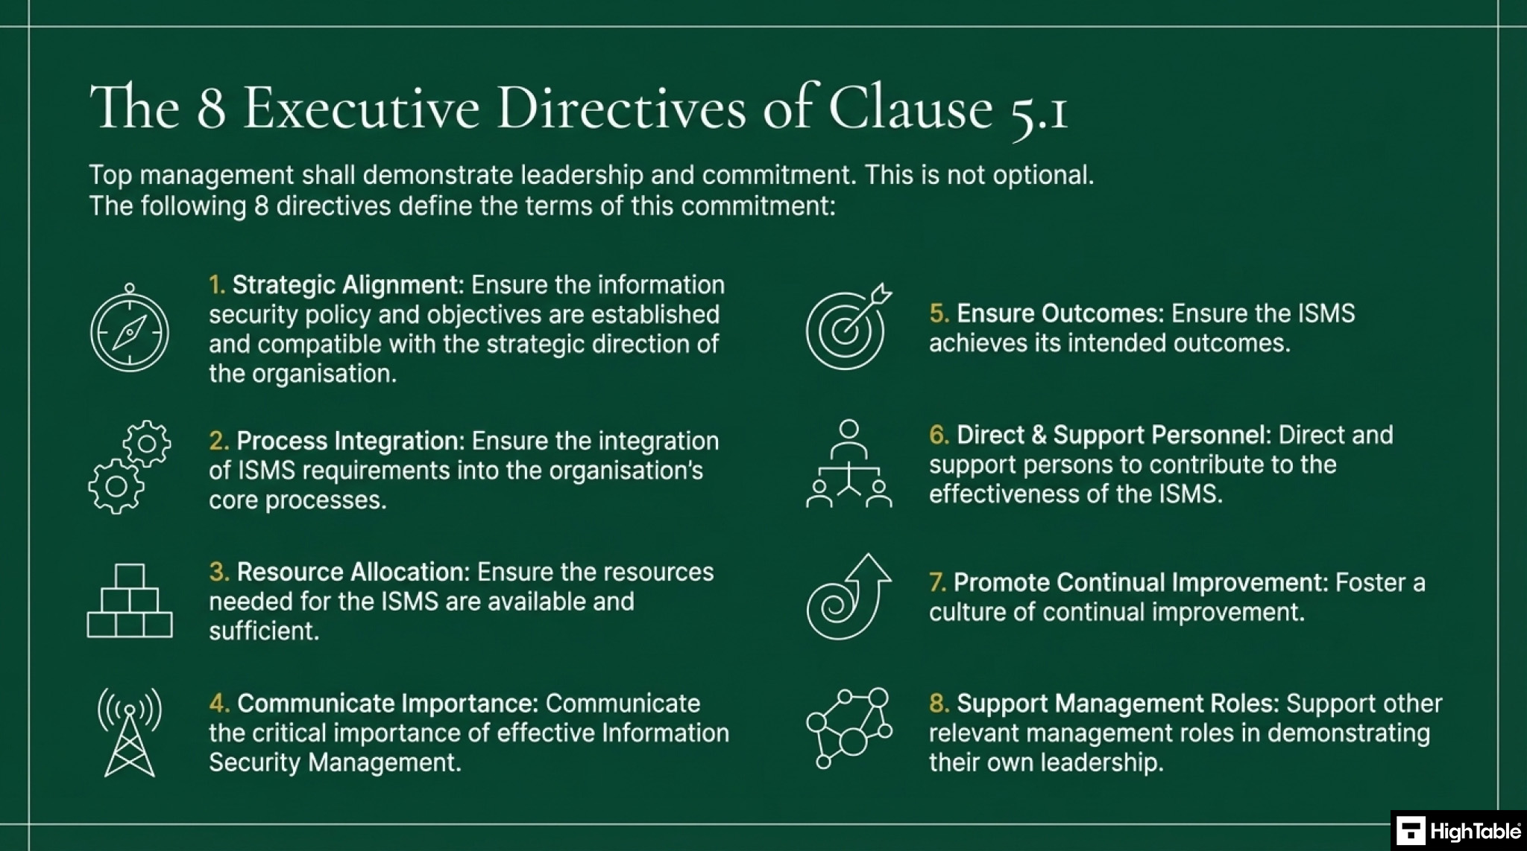
ROLE OF SENIOR MANAGEMENT
ISO 27001: 2022 Clause 5 requires senior management to:
Approve the ISMS scope and policy
Ensure adequate resource allocation
Review performance and improvement actions
Set the tone for security culture

Slide 7
EXPECTED OUTCOMES
After successful implementation, Nususi Sacco can expect:
A structured and auditable IS Management System
Clear ownership and accountability for information risks
Resilience against cyber and operational threats
Enhanced reputation with members, regulators and partners
Reduced operational and audit overheads

Slide 8
RECOMMENDATIONS
Board Action Requested:
Authorize IEC 27001 implementation, funded and resourced under executive sponsorship, to deliver stronger information security, regulatory readiness, and member confidence

Slide 9





Thank You
Tania Bwari
+2547xxxxxxxx
ISO CONSULTANT
bwaritaniah47@gmail.com

